Slide 1
Community Living Experiences, Inc.
CLE Policies and Procedures - Annual Training 2020

Slide 2
Sexual Harassment
Sexual harassment is a form of sex discrimination that violates Title VII of the Civil Rights Act of 1964. Sexual Harassment is a Class _B__ offense.
Unwelcome sexual advances, request for sexual favors, and other verbal or physical conduct of a sexual nature constitutes sexual harassment when submission to or rejection of this conduct explicitly or implicitly affects an individual’s employment, unreasonably interferes with an individual’s work performance or creates an intimidating, hostile or offensive work environment.

Slide 3
Sexual harassment can occur in a variety of circumstances, including but not limited to the following: The victim as well as the harasser may be woman or man. The victim does not have to be the opposite sex. The harasser can be the victim’s supervisor, an agent of the employer, a supervisor of another area, a co-worker, or a non-employee. The victim does not have to be the person harassed but could be anyone affected by the offensive conduct. Unlawful sexual harassment may occur without economic injury to or discharge of the victim. The harasser’s conduct must be unwelcome. It is helpful for the victim to directly inform the harasser that the conduct is unwelcome and must stop. The victim should use any employer complaint mechanism or grievance system available.
Sexual Harassment continued…

Slide 4
Cultural Diversity

Slide 5
What does it mean to be “culturally diverse”?
The term “culturally diverse” is often used interchangeably with the concept of “multiculturalism.” Multiculturalism is defined as:
“…a system of beliefs and behaviors that recognizes and respects the presence of all diverse groups in an organization or society, acknowledges and values their socio-cultural differences, and encourages and enables their continued contribution within an inclusive cultural context which empowers all within the organization or society. (Belfield, 2012)
“Diversity is the one true thing we have in common. Celebrate it every day.” –Anonymous

Slide 6
Attendance Policy
Tracking tool used to monitor compliance with our policies
Disciplinary actions are administered for violation(s) of CLE’s attendance policies and not the accumulation of points.
Excused absences include: Vacations (w/prior approval), Holidays, trading shifts with peers (w/prior supervisory approval), Employee’s own critical/catastrophic medically documented illness, Death /Critical Illness in the employee’s immediate family (w/ supporting documentation), Jury Duty, Approved Leaves of Absence (including bereavement leave w/ supporting documentation), Family & Medical Leave, Occupational Injury time off, preapproved sick leave, and CLE declared adverse weather day (at Management discretion).
Point Range | Action
0 Points | Perfect Attendance – No Action
1 to 5 points | Acceptable attendance – No Action
6 to 9 points | Threshold before Unacceptable Attendance {A Warning Letter will be sent via U.S. Mail to the Employee.}
10 to 14 points | Unacceptable Attendance - Action – Written Reprimand
15 to 19 points | Final Warning of Unacceptable Attendance – Action - Suspension
20 points | Termination

Slide 7
Attendance Policy- Unexcused Absence and Tardy
Points | Event
1 point | Tardy-5 events of arrivals less than 15 minutes after the start of the shift. Late call off (less than 3 hours before start of shift).
2 point | Late Arrival/Early Departure/Withdrawal of shift acceptance -Late arrival more than 15 minutes after the start of the shift. -Early departure (departing shift before the shift is scheduled to end). -Withdrawal of shift acceptance – Accepting a shift assignment and withdrawing the acceptance prior to the date of the assignment
3 point | Unexcused absence or pattern of leave usage
10 point | No Call, No Show
Accumulation of 20pts will result in termination of employment.
Only a company executive can make exceptions to the point system.

Slide 8
Med Admin and Disposal Policy
Medication will be administered according to the 6 rights of med admin.
Dose, route, time, individual, medication, and documentation.
If an individual refuses a medication, every effort should be made to re-approach the individual (at least 3x) during the 2 hour window, in an attempt to gain compliance.
A self medication assessment will be completed initially and every 3 years (minimum) after, with annual update each year.
Medication will be stored in a secure location within each of the home setting.
The disposal of prescribed medication will be recorded and the medication will be placed in an envelope, labeled, and disposed of following pharmacy recommended procedures.
One person can not dispose of a med. Must be two people and they both can’t be DSP’s.

Slide 9
Med Admin and Disposal Policy continued….
All PRN medications will be listed on the MAR with specific parameters for usage.
Keep in mind you need to contact the Viaquest nurse for approval.
Document the information on back of sheet.
Staff should observe the individual for the first 20 minutes and a recheck will be completed at the end of the hour to determine effectiveness.
Adverse reactions need to be documented on the MAR and the nurse contacted immediately so further action or treatment can be initiated when needed.
Death of Individual/Medication Handling in the event of the death of an individual, an accounting of the medications will immediately be completed.

Slide 10
HIPAA

Slide 11
Personal Electronic Devices
What are PED’s?
Prohibits the use of all PED during work hours
Secured locked area
Personal phone conversations, text messages, or any other type of internet communication
WHY? - Personal calls, e-mail, text messaging, school work - can interfere with the security, safety, and care of our consumers.
Violation is a class B offense.

Slide 12
Prohibition of Fire Arms
All CLE employees are prohibited from bringing firearms onto the premises where CLE is providing services, on any CLE property, or while conducting CLE related business.
There are no exceptions to this rule. This is a violation of CLE policies and procedures. The FIRST offense will result in termination.

Slide 13
Attestation Agreement

Slide 14
Attestation Agreement
I hereby attest that I have not: 1) been convicted of, 2) pleaded guilty to, or 3) been found eligible for intervention in lieu of conviction, for any of the disqualifying offenses listed below and agree that I will notify my employer, _________________________________________ , (Employer's Name) within 14 calendar days, if while employed, I am formally charged with, am convicted of, plead guilty to, or am found eligible for intervention in lieu of conviction for any of the disqualifying offenses. I understand that failure to make this notification may result in termination of employment.

Slide 15
Food and Clothing Policy
Clothing
Please make sure our folks are dressed appropriate for the weather.
All CLE individuals shall have personal clothing that is in good repair, well fitting and comparable in style to what is worn by age peers. Individuals should choose what he or she wishes to wear. If individuals do not have money to purchase clothing, the staff should notify the appropriate site coordinator in order to plan for the purchase of new clothes.
Upon admission of a home, CLE shall record clothing and personal items on an inventory and regularly update regarding new and discarded clothing. Clothing should not be discarded without the individual’s consent. IP’s may dictate no need to keep a clothing inventory particularly in a supported living site.
Any single item over $50.00 that is purchased needs to be added to the above mentioned inventory.
The issue of managing his or her own clothing and personal possessions should be identified in the individual’s plan. Staff should notify the site coordinator in order to have this identified in the individual’s plan.
Food
Foods for all CLE individuals will meet nutritional needs and be based on individual preferences. What is identified in the individual plans will be followed, including prescribed diets. In the licensed facilities, menus will be kept of meals served for the previous 30 days. Menu modifications will be noted.
Food shall never be denied as any form of discipline. This includes snacks.
Fresh foods sufficient for at least three (3) days shall be kept in the home. Fresh foods include milk, juice, eggs, lunch meat, etc. For staple items at least five (5) days of food needs to be on hand. Staple foods consist mostly of cereal, canned goods, etc. Licensed homes must adhere to this and supported living should use this as a guideline.
Food shall be stored properly in accordance to health codes. Food products should not be stored with cleaning and laundry products. It is best practice to keep frozen foods and all foods, if possible by dates with the oldest date nearest to the front of the storage area.

Slide 16
Personal Appearance and Grooming
Prohibited clothing includes but is not limited to:
Dirty, damaged, torn or excessively worn clothing.
Clothing bearing language, artwork or other messages which may be offensive, controversial or contrary to the mission and/or professional image of CLE.
Discretion regarding wearing jeans is to be observed. (i.e. if a meeting is scheduled with other professionals, jeans would be inappropriate). Flip-flops are also inappropriate in work settings. Bare midriffs, halter tops, shorts, micro-mini-skirts, cutoffs, sweatshirts/suits meant for loungewear or see-through clothing is not permitted. Long earrings and jewelry that hangs may not be appropriate in certain settings.
Employees assigned to direct care delivery or maintenance classifications may wear appropriate “work clothes” approved by their immediate supervisor. On a case-by-case basis, supervisors may approve work clothing for other employees as needed.

Slide 17
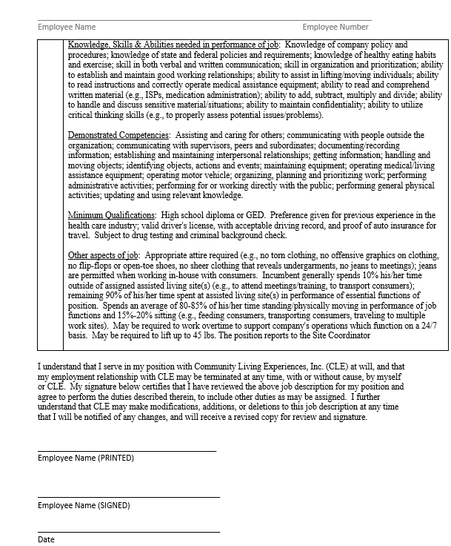
Job Description

Slide 18
Employee Status
Full-time Status
Work average 32 hours
Part-time to Full-time if average 64 hours for 4 consecutive pays
Full-time to Part-time with less than 64 hours for 4 consecutive pays
Status in Relation to Benefits
Full-time in order to accumulate sick time.
Full-time eligible for vacation on their one year anniversary of the date they became full-time
Full-time eligible for group health insurance after 90 days, plus 8 consecutive weeks of 30 hrs. per week. If 8 consecutive weeks are interrupted, the employee must re-start the 8 weeks waiting period. – see Jeanette.
Overtime Compensation
All hourly employees will be paid overtime compensation for time worked that exceeds 40 hours in a one week period beginning Sunday at 12:01a.m. and ending Saturday at 11:59p.m.
Overtime compensation is 1.5 times the employee’s regular rate of pay.

Slide 19
Timesheets
ALWAYS PRINT your name at the top in the blank provided. Fill in the department, month and year. The only place your signature appears is at the bottom with the date. If we receive an incomplete time sheet, i.e. only a first name, scribbled name or other incomplete information, you will be notified. You must re-submit a corrected time sheet immediately; otherwise, you may not be paid.
Fill in the “time in” and “time out” and “what” (i.e. description – use the time key at the bottom of the timesheet—i.e. as in today’s case, use “O” for orientation. ALWAYS include “A” for A.M. or “P” for P.M. and be consistent. Please TOTAL EACH COLUMN. If your shift starts at 12 a.m. (MIDNIGHT), that is considered the NEXT DAY!!
Fill in the DATE above the day. You are paid from Sunday to Saturday. If you work over 40 hours in one week, it is considered overtime. Your overtime is not based on the two week total.
FILL IN ALL HOURS ON ONE SHEET ONLY UNTIL THE DAY IS FILLED UP, THEN AND ONLY THEN CAN YOU USE ANOTHER SHEET – If you use more than one sheet please number your sheets.
NEVER use NICKNAMES on any documents you submit. PLEASE USE THE CORRECT FORM- ALWAYS. You MUST fill in the appropriate date above the day.
Time sheets ARE TO BE SUBMITTED to the Payroll Department by 5:00 pm the Monday following the end of the payroll period. NO TIME SHEET – NO PAY UNTIL THE NEXT PAY DAY.. It is your responsibility to submit your time sheet. Office fax #614-588-0329. If you are faxing in your time sheet – EACH EMPLOYEE MUST HAVE ONLY ONE (1) TIME SHEET NO MATTER WHERE YOU WORK.
In accordance with Ohio law, you are not paid for time changes (i.e. daylight savings to standard time and back as in spring and fall).

Slide 20
Hazard Communication
Be familiar with the hazardous chemicals and combustible materials used or stored in your work area and know how to protect yourself from the hazards they represent.
Do not use hazardous chemicals or combustible materials unless you have been trained to do so safely.
Material Safety Data Sheets (MSDS’s) are located at the office.
Never use a chemical in an unmarked container unless the contents are known specifically to you or a co-worker.
Report all spills of hazardous chemicals to your Supervisor.
Advise contract employees of chemical hazards and combustible materials they may encounter while on the premises.
Review safety procedures before undertaking any new and/or non-routine task.
Distribute employee safety manuals during annual training.

Slide 21
Emergency Policy
NOTE: An emergency illness or injury is one in which death or permanent disability may result within the hour. Examples of emergencies are as follows:
Loss of heartbeat
Breathing stops/difficulty breathing
Blow to the head (compare to being hit with a ball bat or falling and hitting head on concrete)
Uncontrollable bleeding
Unconsciousness; coma
Poisoning
Status epilepticus (uncontrolled seizures/seizures lasting longer than two (2) minutes/individual who does not fully wake up within 20 minutes following a seizure
Crushing injury of the head, chest, or abdomen
Any fracture of the long bones of the extremities
Severe bee stings (complicated by allergies) Example: massive hives, difficulty breathing, feeling of throat beginning to swell, or losing consciousness
Hypoglycemia (low blood sugar which does not resolve with or cannot be resolved by nutritional intervention with food
PURPOSE: To prioritize the necessary steps to handle urgent and emergency situations that may arise with our consumers and employees of Community Living Experiences, Inc. Be advised that often the speed and correct order of which these procedures are completed could very easily mean the difference between further emergencies or successful outcome by you the provider maintaining control.
Minor injuries can be stabilized per first aid training and evaluation on site by a trained health care provider and transported to the hospital or urgent care facility as directed. However, major illnesses require immediate attention and need professional action within minutes.

Slide 22
Corrective Action

Slide 23
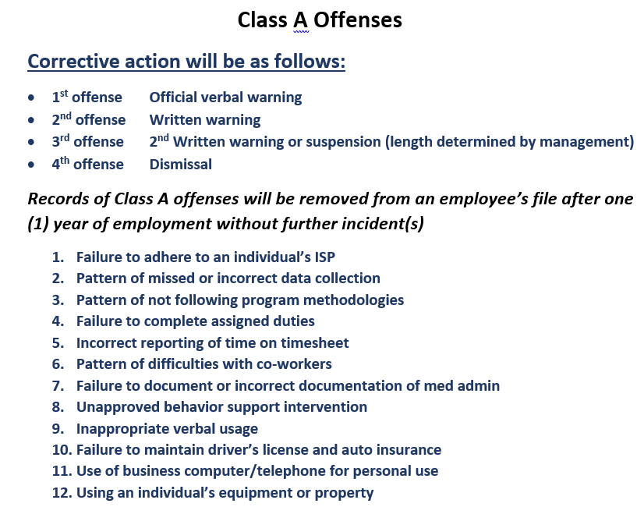
Corrective Action

Slide 24
Corrective Action

Slide 25
Corrective Action

Slide 26
FMLA
Unpaid job protection for qualifying serious health conditions.
Work 1 year for CLE
Accumulate 1250 hours within a one year period.
Notify HR if you know ahead of time.
Once deemed eligible, certification from a healthcare provider must be returned to determine whether the health condition is designated as an FMLA qualifying event.

Slide 27
FMLA
https://www.dol.gov/agencies/whd/fmla
If an employee submits certification on 1/19/2016 the “month” will be defined as 1/19/2016 through a period of 30 days beginning on day of certification (1/19/16 through 2/17/16).
The week is defined as Saturday through Friday.
The year is defined as 1/19/2016 to 1/19/2017
An employee’s FMLA certification states they may be off work 1x per month for 1-2 days per episode. The employee calls off work for FMLA on 1/19/16, the FMLA is approved. The employee then calls off on 1/20/16, the FMLA is approved. Then the employee calls off on 1/21/16, the FMLA is NOT approved because the call off request for FMLA is outside the certification (only 1-2 days per episode).

Slide 28
Call Off/Switch shift policy
ON-CALL NUMBER: 614-588-3376
Notification to Site Coordinator/On-call Supervisor must be made no later than 3 hours before the start of the shift. Notifications made less than 3 hours before the start of the shift will be deemed a late call-off and subject to possible corrective action.
All employees must know the phone number(s) of the (site(s) they work at, the number for the On-call Supervisor and the number for the On-call Program Director. If the Site Coordinator (or On-call Supervisor) does not respond within fifteen (15) minutes, the On-call Program Director must then be called. It is unacceptable to use texting or e-mail to call off.
A Switch Shift change must be made no later than 24 hours before the start of the impacted shift. The Switch shift must be accepted by both employees and the two shifts must be within the same 40 hour work week. The Switch Shift Form must be completed by the employee and submitted to and approved by the Supervisor. Switch Shift requests shall not be unreasonably denied. If an employee does not honor their commitment to the Switch Shift they may be subject to corrective action.

Slide 29
Work Assignment
It is the policy of Community Living Experiences, Inc. (CLE) to ensure a standard of staffing levels that are sufficient to insure safe, high quality and effective delivery of consumer services. In order to meet CLE’s standard for staffing levels, all employees shall be assigned a regular work assignment and shift. A regular work assignment is defined as the physical setting wherein an employee performs his/her assigned work on a regular basis.
Employees are required to remain in their regular work assignment for 6 months. Employees are limited to two (2) changes in their regular work assignments in a rolling 12 month period. An employee must meet any professional needs required in the requested regular work assignment and shift, including but not limited to the best interest of the consumer.
CLE shall not unreasonably deny an employee’s request for a change in their regular work assignment. However, all requests for an Employee’s change in regular work assignment is subject to the operational needs of CLE.
CLE maintains the right to temporarily and permanently pull staff based on the operational needs of CLE.
Staff requests based on documented education schedule changes will be considered on a case-by-case basis.

Slide 30
Holiday Compensation
Due to the nature of the services we provide, it is often necessary to have staff scheduled on holidays. At all times, the best interests of the consumers will be ensured. Effective 2/1/04, all employees will receive compensation at 1.5 times their regular wage when working hours on the following holidays:
New Years Day
Martin Luther King Jr Day
Memorial Day
Independence Day
Labor Day
Thanksgiving Day
Christmas Day

Slide 31
Smoking policy
Community Living Experiences, Inc. is a smoke-free workplace. All Licensed Homes are considered a workplace for our staff as well as being our clients’ homes.
As a workplace, it is a violation of state law to smoke inside of our locations. When driving our vehicles, these are also considered as your work environment. There is no smoking allowed in our vehicles.
When working in a Supported Living Site, it is also considered a worksite and the policy applies as well.
There are designated areas outside of the homes where staff may smoke when off duty. Our clients may also use these areas as desired.

Slide 32
Visitation Policy
Visitations by friends, family, and associates of staff are strictly prohibited in the setting where the consumer resides. Any visitations at the work site by family members of employees will be considered a violation of company policies and procedures. Disciplinary action will be taken regarding violation of this policy.
A checklist will be completed by the site coordinator or the program director prior to any visitations. These visits must be completed when the staff is off duty and cannot be used for one on one time. The site coordinator will seek approval from the guardian if applicable. The individual must also wish to visit with the staff person’s family and/or friends. Also, a pre-visit must be completed and approved before the visit can occur.
If an individual wishes to visit with a staff person’s family or friends of the employee, the employee must first seek approval from the site coordinator, area coordinator and/or the program director.
ALL VISITS MUST BE CONSUMER DRIVEN.
THESE VISITS SHOULD BE KEPT TO A MAXIMUM OF THREE HOURS.
Pets should NEVER be present for any visitations.

Slide 33
Vacation Time
Full-time regular employees, after their one (1) year anniversary as detailed in the “Employee Status” section of this handbook.
Hourly employees are entitled to vacation time as follows:
* one (1) year = 40 hours
* two (2) years = 80 hours
* three (3) years = 120 hours
* succeeding years = 120 hours
Vacation time must be used prior to new anniversary date and cannot be accumulated. Failure to do so could result in loss of benefit, but any hourly employee who has accumulated 120 hours of vacation may have the option of receiving 40 hours of pay in lieu of taking the time off with the following condition. The employee must have already used 80 hours of vacation time out of their 120 hours. The 40 hours of vacation time must be used at one time and not broken up into more than one payroll period.
Emergency requests for vacation without proper advance notice will be subject to approval by the Site Coordinator under the guidance of the Program Director.
The administration of this agency is not obliged to honor vacation date requests; vacations shall be approved only after scheduling needs are met. Earned vacation time shall be used within a 12 month period. In extraordinary circumstances, the CFO may approve the carrying over of earned vacation past a 12 month period.
Resignation or termination of employment disqualified employees from any and all vacation time benefits due or accrued.

Slide 34
1-2 DAYS = 7 DAYS IN ADVANCE
3 DAYS = 15 DAYS IN ADVANCE
4-5 DAYS = 30 DAYS IN ADVANCE
Must be submitted in writing!!!!!

Slide 35
Financial Policy – revised 9/25/20
All individuals will be given the opportunity to manage, be taught to manage, or receive assistance with managing their personal funds.
The ISP will identify the payee, maximum dollar amount that the individual can manage at one time independently, and maximum dollar amount that can be spent without guardian, payee, and/or team approval. Individuals will not be asked to use personal funds to purchase items or services that are funded through other sources. CLE staff, nor immediate family members, shall not borrow, trade, buy, or sell items from individuals that CLE serves.
all individuals will have their own account (either savings or checking account). An arrangement with a banking institution has been made for no fee accounts. This assures no co-mingling of funds on any level. It is not appropriate for one individual to borrow money from another individual. If roommates share household supplies, etc., it must be documented. Summary transactions are available to authorized parties upon request.
When checks are deposited into the account the entire amount must be deposited. If the individual needs to withdrawal money, it is a separate transaction.
DoDD Rule can be found at the following link:
https://dodd.ohio.gov/wps/portal/gov/dodd/forms-and-rules/rules-in-effect/5123_2-2-07

Slide 36
Example: Suzy has a paycheck for $40.00 and she needs $20.00 for the weekend. A deposit slip will be written out for $40.00 and a withdrawal slip for $20.00. Suzy will have two transactions at the bank. There should be a bank receipt for both transactions. This will then be transferred to the bank account ledger. (See example of ledger) All checks must be deposited into the accounts within five business days of receiving the check.
Financial Policy continued…

Slide 37
Financial Policy continued…
All checks must be deposited into the accounts within five business days of receiving the check.
All receipts must have a number written on them by the Site Coordinator.
There must be a receipt for every penny that the individual owns. If the individual is going to a place where you cannot obtain a receipt then you must write one out using the receipt book.
CLE will seek restitution from staff person(s) responsible for and discrepancies with the money.
Do not add all receipts together and only write down one amount. Each receipt must be written down separately.
Staff cannot put two individuals on the same receipt and photo copy it for the other individual.
Example: Jane and Tammy went to McDonalds for dinner. They both must have their own receipt from McDonalds. All receipts should be kept in a container, either a money pouch or envelope. The receipts can be archived when a new year begins.
On Hands Funds- money is the spending cash that is kept at the home in a locked box.
When gift cards are in the home, they must be recorded on the gift card tracking sheet along with any receipts.
These are reconciled on a monthly basis.
Staff must count the on hands money for each individual at the beginning and end of their shift.
Any discrepancies must be reported to CLE management within one hour of discovery.

Slide 38
There is to be no co-mingling of individual funds. If an individual is short two dollars at the store staff can not give them the money for the individual to pay back later. At the same time staff can not take money out of another individual’s money for them to pay back either. If the staff does give money to an individual it is with the understanding that it is a gift and will not be paid back in the future. This also stands for the individual paying for things for staff. This is prohibited. The individual can not pay for the staff’s dinner, movie, etc, unless it is stated otherwise in their ISP.
Financial Policy continued…

Slide 39
IN CONCLUSION…
If you are ever have questions about a policy, please contact your supervisor.
If you are unsure about any aspect of your job duties, make sure to reach out to management to seek clarity.
If you are unsure about any aspect of caring for our consumers, please reach out to your supervisor.
Communication is key for CLE!

Slide 40
Works Cited
Belfield, D. L. (2012, December 18). Purdue University Global. Retrieved from Purdueglobal.edu: https://www.purdueglobal.edu/blog/social-behavioral-sciences/what-is-cultural-diversity/

